Slide 1

REVOLUTIONIZING HOME AUTOMATION
WITH AI

Slide 2

CONTENTS
1
2
3
4
5
INTRODUCTION
SMART HOME DEVICES
BENEFITS OF AI-POWERED HOME AUTOMATION.
SECURITY AND PRIVACY
FUTURE OF AI IN HOME AUTOMATION

Slide 3
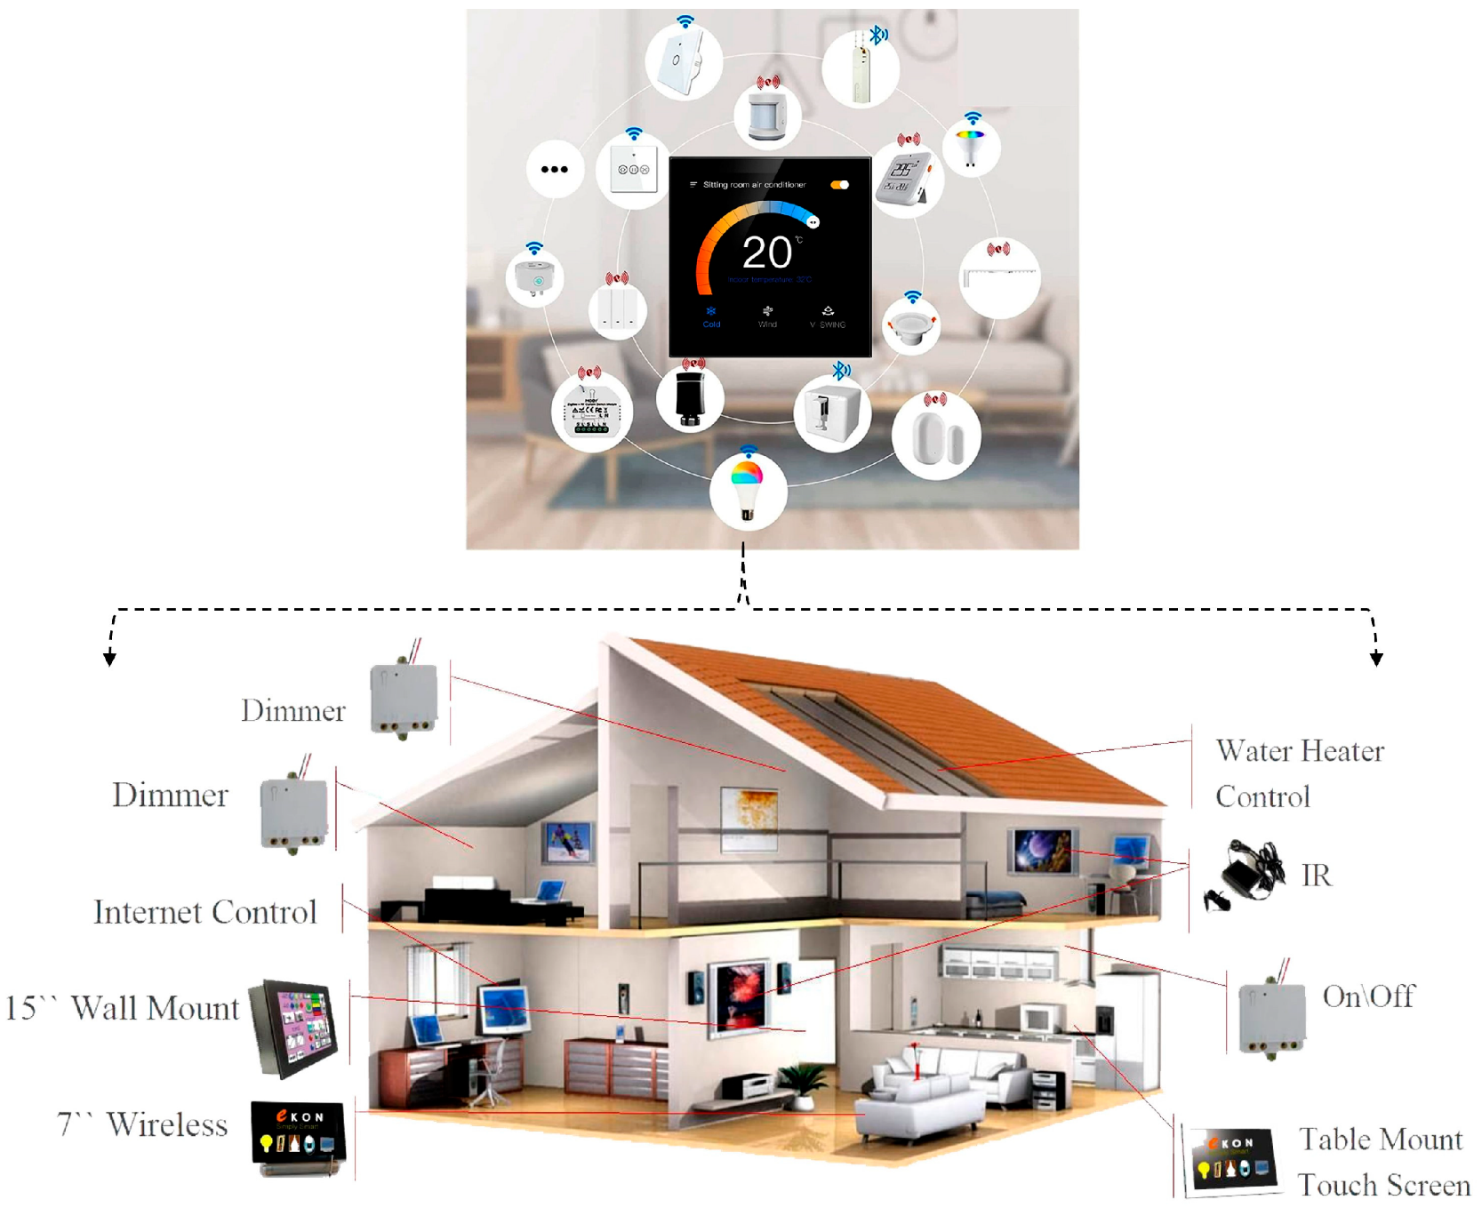
PART - 1
INTRODUCTION
Welcome to our presentation on AI-powered home automation and the benefits it brings to households. In this presentation, we will explore the ways in which AI is transforming the way we live in our homes, from smart devices to security and privacy. We will also discuss the future of AI in home automation and how it will continue to shape our daily lives.

Slide 4
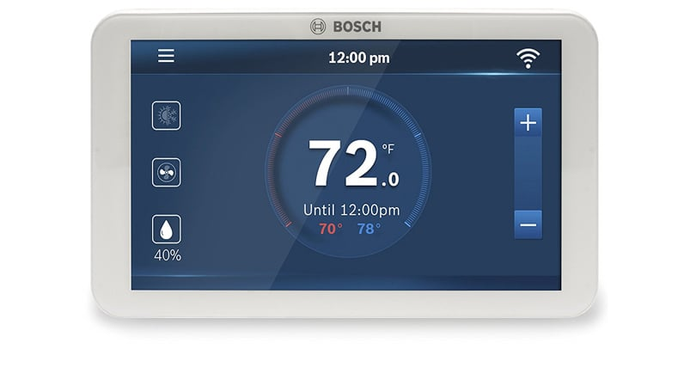
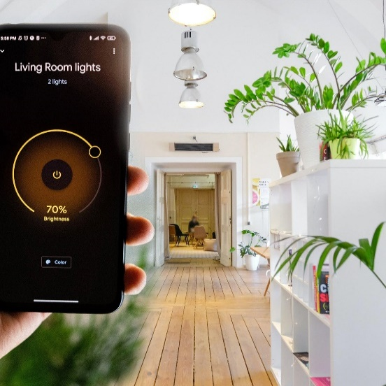
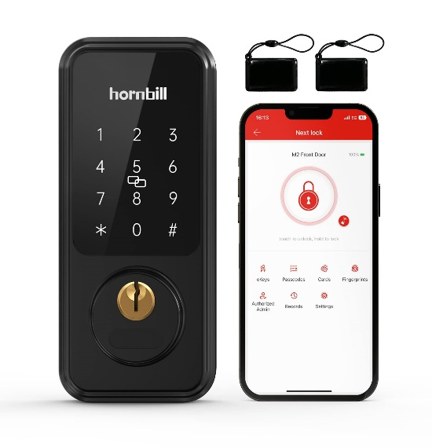
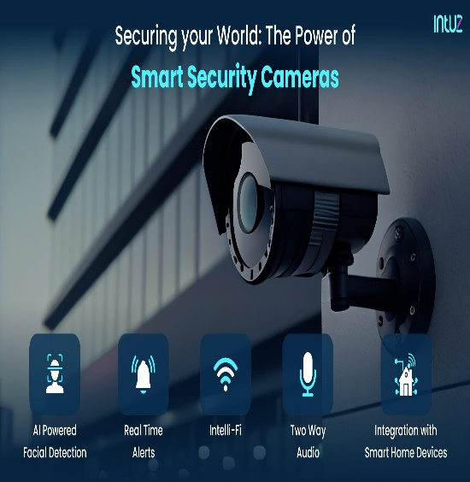
PART - 2
SMART HOME DEVICES
Smart home devices are internet-connected devices that allow remote monitoring and management of household appliances and systems. These devices are designed to make life easier, more convenient, and more efficient for homeowners.
Examples of Smart Home Devices
Smart thermostats that learn your temperature preferences and adjust accordingly
Smart lighting systems that can be controlled remotely or set to turn on and off automatically based on your schedule
Smart locks that allow you to lock and unlock your doors remotely or set up access codes for guests
Smart security cameras that provide real-time monitoring and can be accessed remotely

Slide 5
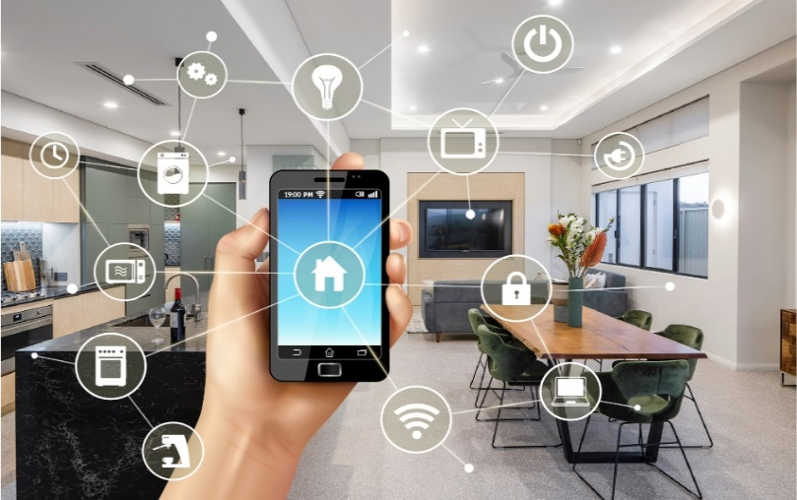
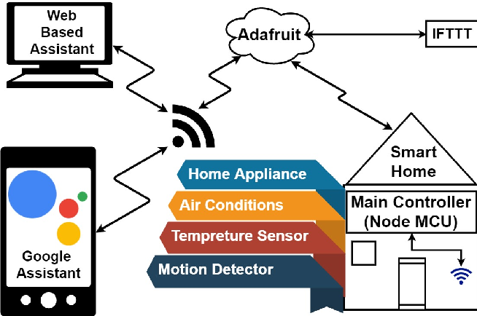
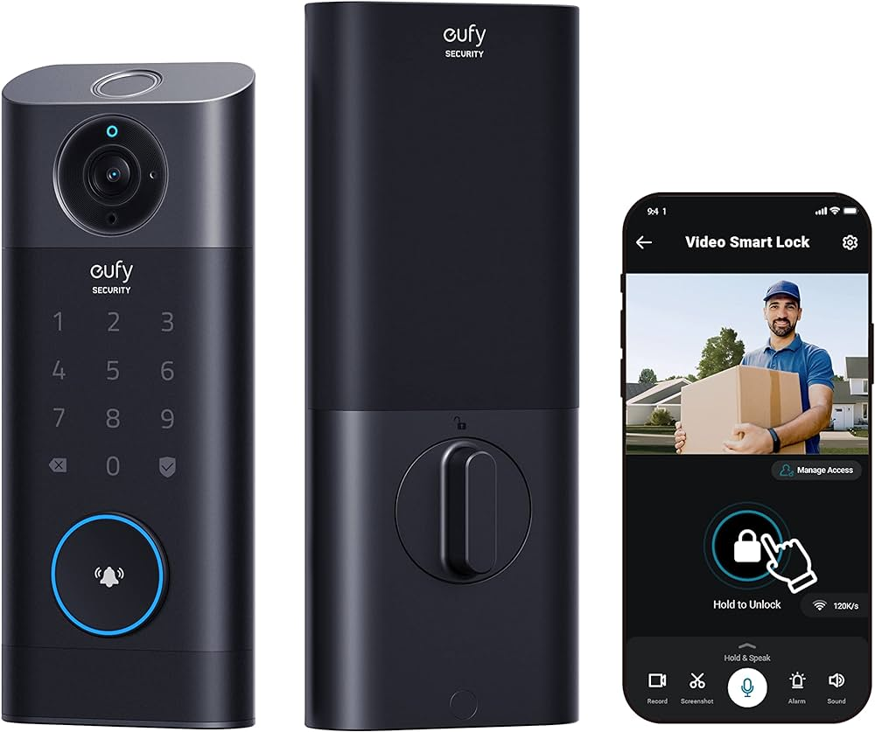
PART - 3
BENEFITS OF AI-POWERED HOME AUTOMATION
·
CONVENIENCE AND COMFORT
ENERGY EFFICIENCY
IMPROVED SECURITY
AI-powered home automation can help households save on energy bills by optimizing the use of energy-consuming devices. Smart thermostats, for example, can learn your temperature preferences and adjust accordingly, while smart lighting systems can turn off lights in empty rooms. This not only saves energy but also reduces your carbon footprint..
AI-powered home automation can enhance the security of your household. Smart security cameras with motion detection can send alerts to your phone when there is suspicious activity, while smart locks can be controlled remotely, allowing you to let in guests or service personnel without having to be physically present. This can give you peace of mind and make your home a safer place.
AI-powered home automation can bring a new level of convenience and comfort to households. With smart home can easily adjust the temperature, turn on/off lights, and even start devices that can be controlled by voice or through an app on your phone, you your coffee maker without leaving your bed.

Slide 6

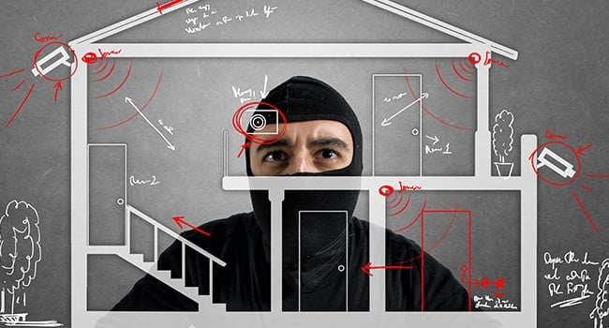
Security and Privacy
PART - 4
One of the biggest concerns with home automation is the security and privacy of personal information. However, with AI-powered home automation, security is greatly enhanced through features such as facial recognition and voice authentication. Additionally, AI algorithms can detect and alert homeowners of any unusual activity or potential security breaches.
Privacy Concerns
AI-powered home automation also takes privacy concerns into consideration. Personal data is securely stored and encrypted, and homeowners have control over who has access to their devices and information. Additionally, AI algorithms can learn and adapt to homeowners' preferences, without compromising their privacy.

Slide 7


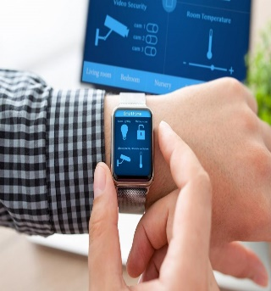
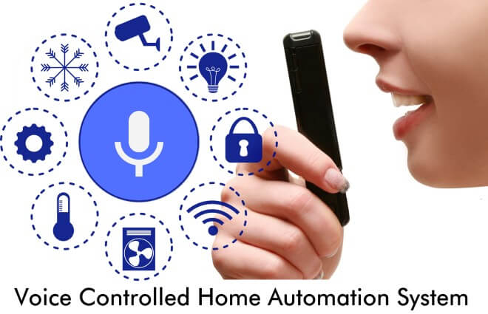
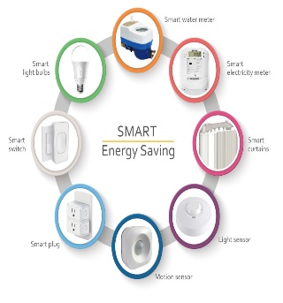
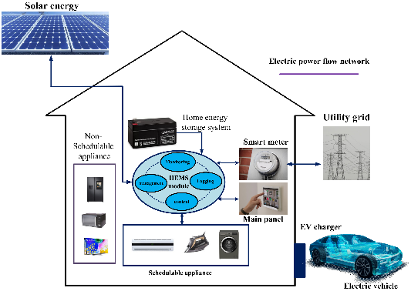
PART - 5
FUTURE OF AI IN HOME AUTOMATION
ENHANCED WEARABLE INTEGRATION
VOICE CONTROL DOMINANCE
EFFICIENT ENERGY MANAGEMENT
RENEWABLE ENERGY INTEGRATION
Expect deeper integration with wearable tech for personalized automation.
Greater reliance on voice-activated assistants for intuitive device management.
Improved energy efficiency with AI systems optimizing heating, cooling, and lighting.
Integration with renewable sources like solar panels and wind turbines to reduce grid reliance and lower energy costs.

Slide 8
Thanks for watching
Designed and created by
PRANEET
NOYAL

